Slide 1
STM32H750IBK6 SOM Ratatouille V1

Slide 2
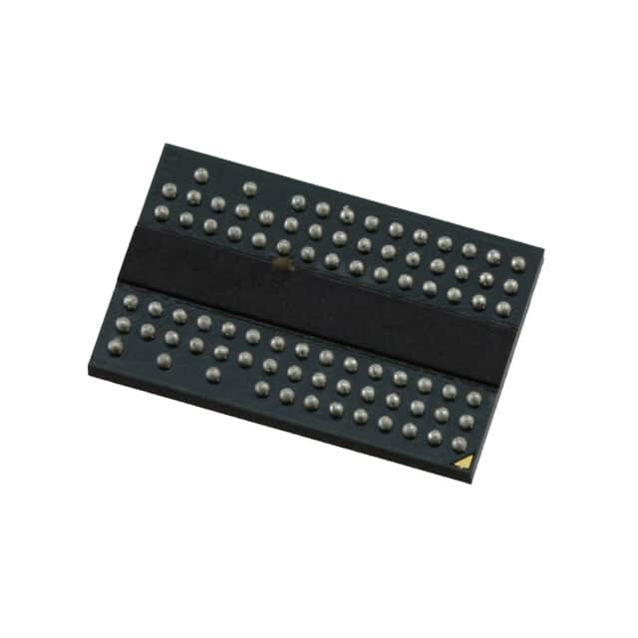
Core Spec
X1 external IS43DR16320E 512MBit (64MByte) DRAM
Reason
16 bit, 13bit address which would fit stm32 FMC
Reasonable price of 113 Baht
0.8mm BGA is reasonable to design 8 layer board for JLCPCB
84 BALL BGA 0.8mm Pitch

Slide 3
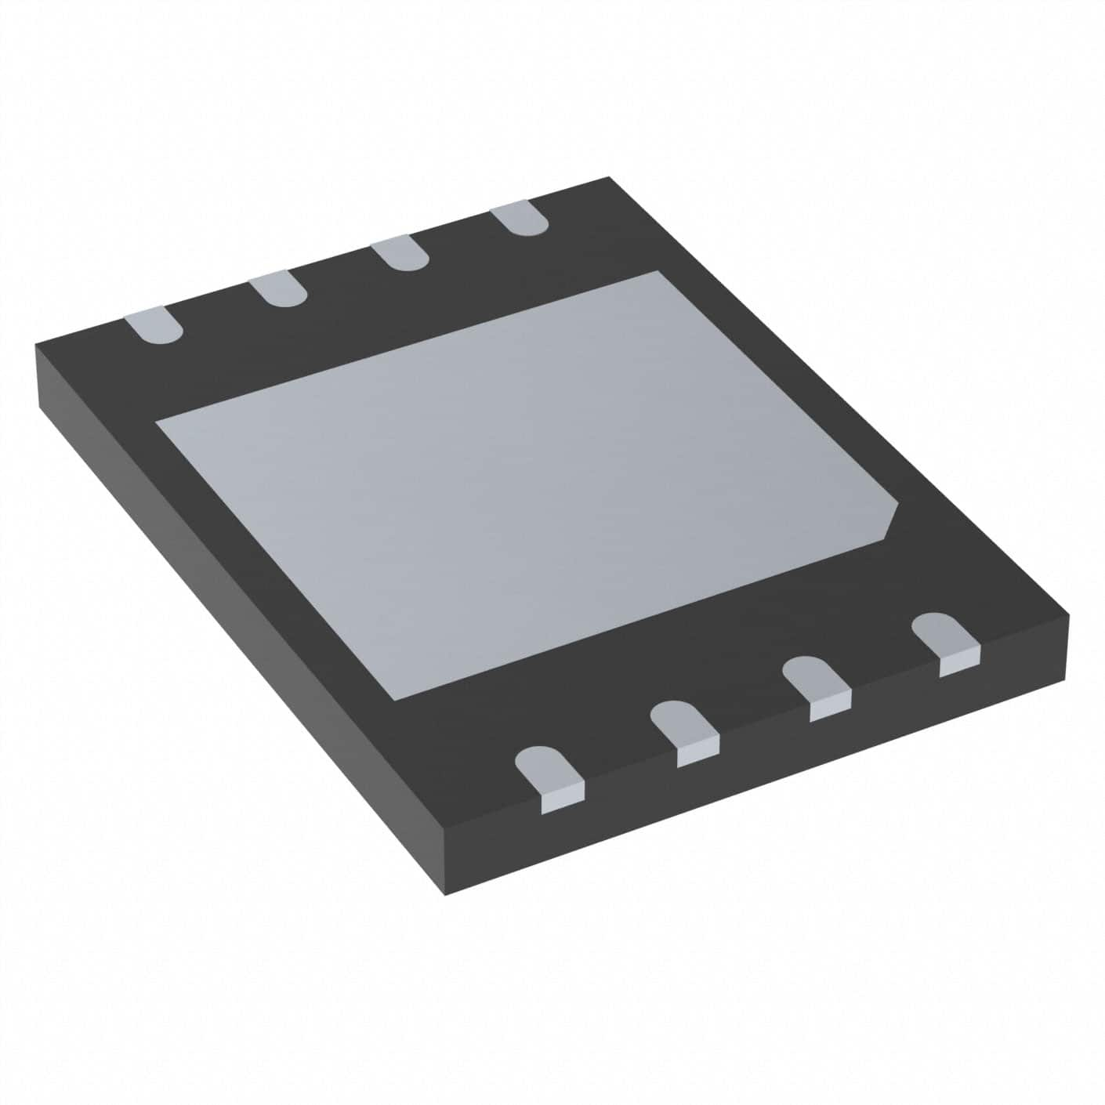
Core Spec
X1 external QSPI W25Q256JV
WSON-8

Slide 4
Core Spec
X1
WSON-8

